Slide 1
Best of
South- East
Program
BOSE
2019/20
Mag. Andrea Baier
Recruiting & Placement
MMag. Marko Markić SEE Strategy and Business Developement

Slide 2
What is Best of South-East?
in cooperation with:
„The only source of knowledge is experience“
Notes:
Each year, the Steiermärkische Sparkasse, in cooperation with the Karl-Franzens University of Graz, University of Technology, University of Music and Performing Arts and Montan University offers around 14 scholarships to students from South East European countries. The program supports young talented students to develop their skills and knowledge and gain professional experience in order to become more competitive on the job market. The program runs each year from 1 September to 31 August.

Slide 3
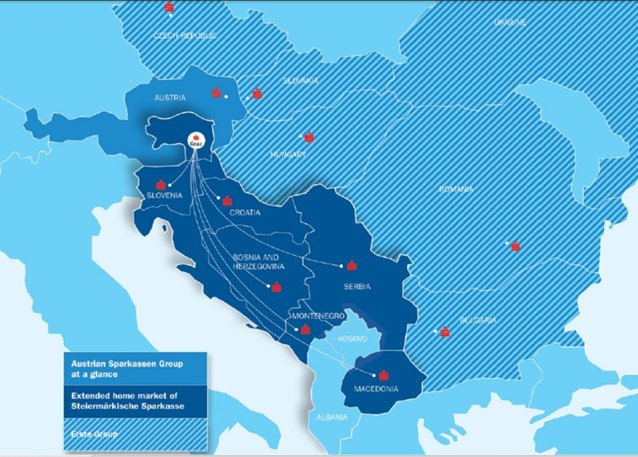
Steiermärkische Bank - Group
7 markets
more than 8,300 employees
approx. 2.6 million clients

Slide 4
Aim of the program
Empowering professional and personal potential
Supporting students in their further academic educational development
Improving German language skills
Providing
international working experience
Making contacts and creating networks
Notes:
To allow young people to achieve their professional and personal potential, preferably in the countries where they originate from. In this way we want to make a tangible contribution to our region:
Becoming a better place to live by supporting young people with high-potential, providing them with valuable cross-border experiences and a good start in their careers;
Creating networks: the Best of South-East participants come from all countries in the region, these networks should ‘‘stay alive‘‘ also after the program.
,,To give enterprising people an opportunity‘‘ is a part of the Sparkasse core philosophy, this is also what we aim to do for our ‚,Best of South-East‘‘ participants.

Slide 5
Best of South-East at University Graz
Graz (Headquarters)
1,500 employees
160 Branches
515,000 clients
Present in Slovenia, Croatia, Serbia, Montenegro, Bosnia and Herzegovina, Macedonia
Karl-Franzens University
Biggest university in Styria
6 faculties
120 study courses
State owned university
Established in 1585
Number of students: 32,500

Slide 6
Trainee Program
Internship Program
Training in different departments
of the bank (10 months)
Duration of program 12 months
Duration of program 12 months
Training in different departments of the bank (2 months)
Target group:
Graduates or
students in business,
economics or law
One month of the program in the home country
Possibility to spend one month in the home country*)
Attending courses at the University of Graz
Attending courses at the University of Graz
German intensive course and opportunity to improve language skills
German intensive course and opportunity to improve language skills
Participation in special social and cultural events
Participation in special social and cultural events
*) depending on availability of funds
Notes:
The difference between the two programs:
10 months or two months training in different departments of the bank, the trainees must spend the final month in their home country;
the interns can choose to spend one month in their home country *) depending on availability of funds.
Trainees selected for the program must complete a minimum of 16 ECTS/academic year at the University of Graz
Interns selected for the program must complete a minimum of 30 ECTS/academic year at the University of Graz

Slide 7
Selection process
Final Selection
of top 8
in Graz
(03/2019)
All applications (12/2018)
Uni Graz Prescreening
Local selection of up to top 3 per country
(02/2019)

Slide 8
Amount of Grant for top 8
The total amount of financial aid per year and participant is a maximum of EUR 10,000,- consisting of:
Various networking events
EUR 690 spending money per month
Tuition waiver for the University of Graz
Intensive language course or semester language course at language center of the University of Graz

Slide 9
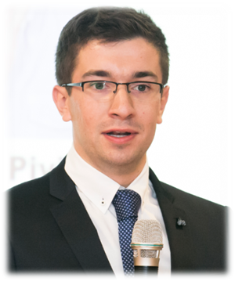
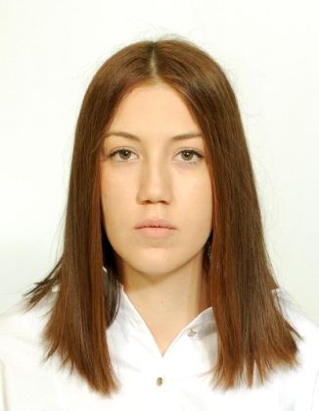
The experience of our Trainees and Interns
“The traineeship enabled me to develop a diverse set of skills, leading to an increase of productivity on the professional, but also on the personal level. Steiermärkische Sparkasse offers ambitious and positive, competitive environment providing trainees with the opportunity for maximum progress and learning.“
(Boris Pivić, Trainee 2014/2015, Bosnia and Herzegovina)
“The past year was unquestionably one of the best periods in my life. Steiermärkische Sparkasse gave me a valuable opportunity to gain insight into the Austrian business system, to learn from its model and obtain knowledge, skills and experience necessary for my future career. Another privilege was continuing my education at University of Graz, which has long-standing academic tradition, that contributed to my academic development and helped me to improve German language. Also, becoming friend with other participants who share the same interests and passions made my one-year journey unforgettable. “
(Kana Bošković, Trainee 2017/2018, Serbia)

Slide 10
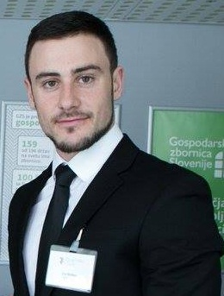
The experience of our Trainees and Interns
“As a trainee in the Steiermärkische Sparkasse bank, I experienced the everyday lives of the people working in many departments. While at first I was only able to observe what the others were doing, at the end I was actively involved in some projects and tasks. The program definitely was a valuable experience and a stepping stone to my future career.”
(Vid Hribar, Intern 2017/2018, Slovenia)
“Best of South East” is a life-changing journey which I embarked upon with great enthusiasm and thirst for knowledge. I was honoured to have been given the ticket for this incredible journey and selected among the candidates to be part of the “Best of South East” family. This internship has been inspiring, adventurous and filled with knowledge. When opportunities knock on our doors, it is up to us to open the door, and behind that door there is experience, friendship and personal growth.”
(Ivana Spirovska, Intern 2017/2018, Macedonia)

Slide 11
Application Requirements
German B1 (trainee) / A2 (intern)
&
excellent English
native language:
Slovenian
Bosnian
Croatian
Serbian
Montenegrin
Macedonian
max. 27 years at the time of application
strong communication skills
flexibility
analytical and practical thinking
Alumni and students of business, economics or law at an accredited university
Notes:
You have a good knowledge of English and German (German: B1 for Trainees, A2 for Interns).
Your native language is: Slovenian, Bosnian, Croatian, Serbian, Montenegrin or Macedonian
You have a degree or you are a student in the last third of your studies in business, economics or law with very good marks
Your age: max. 27 years at the time of application
You have dedication, strong communications skills, flexibility, analytical and practical economic knowlegde

Slide 12
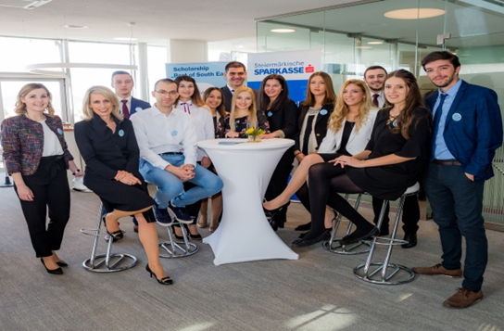
Thank you
It will be a pleasure
for us to welcome you
at our headquarters
in Graz!

